Slide 1

MentiScope Cognitive Assessment Platform
Visual Processing Speed (Gs)
Vinay Kartheek Bathala

Slide 2

Prototype Evolution :
Old MVP vs New Refined Model
Attribute | Old MVP Model | New Refined Model
Session Scope | 120-second open-ended session; unlimited trials. | 20-trial hard limit (5 trials per module) within 120s limit.
Module 1 (Symbols) | Complex strings (3-4 characters); caused visual lag. | Simplified strings (2-3 characters); rapid identification.
User Progression | High risk of getting stuck on a single module. | Guaranteed coverage of all 4 modules (auto-advance).
Odometer Bounds | Negative math calculations could cause dial misalignment. | Odometer display capped at 0; preserves premium layout.
Data Integrity | Legacy database entries caused empty values on dashboards. | Auto-heal variable mapping for backwards compatibility.

Slide 3
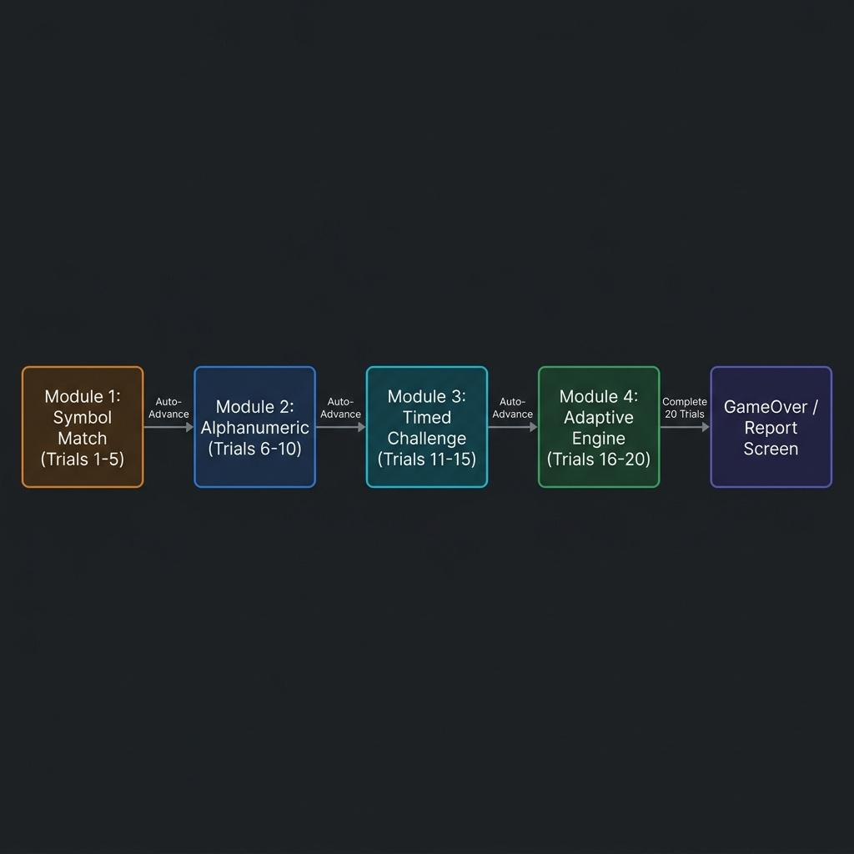
Assessment Workflow & Backend Pipeline
Adaptive Progression Tiers:
Promotion : Streak of 3 correct answers advances difficulty level.
Demotion : Streak of 2 errors/timeouts demotes difficulty level.
Psychometric Scoring Formula
Composite Score=(0.30×PS)+(0.25×VSE)+(0.20×RC)+(0.25×SAT)Composite Score=(0.30×PS)+(0.25×VSE)+(0.20×RC)+(0.25×SAT)
Perceptual Speed (PS) : Matches completed relative to an 800ms baseline.
Visual Scanning (VSE) : Targeting speed measured before the first mouse click.
Rapid Classification (RC) : Accuracy weighted by average difficulty levels.
Speed-Accuracy Trade-off (SAT) : Response precision scaling under pacing pressure.

Slide 4
Development Status & Roadmap
Current Achievements and Next-Stage Prototype Priorities
What's Completed (Active Prototype):
Fully functional adaptive difficulty loop across 4 distinct modules.
Visual progress tracker (Q: X/20) and capped odometer.
Dynamic admin panels featuring real-time leaderboard, database tab views, SQL/CSV data exporters, and interactive developer documentation.
Next Steps & Roadmap:
Phase 1: Student Cohort Norming: Run pilot trials with 100+ students to establish localized processing speed percentiles.
Phase 2: Mobile Interface Tuning: Optimize matrix layout and tap targets for tablets and mobile viewports.
Phase 3: Cognitive Integration: Link student recommendations with specific learning management system (LMS) modules.

Slide 5
Key Takeaways
A Robust, Scientifically-Aligned Processing Speed Engine
Minimized Construct Contamination: Short strings (<= 4 chars) ensure scores represent scanning speed, not working memory span.
Enhanced Engagement: 20-trial hardbound limits visual fatigue while retaining statistical significance
(r≥0.80 split-half reliability).
Actionable Interventions: Automates student profiling into 4 cognitive archetypes (e.g. Efficient, Impulsive, Meticulous) with targeted learning recommendations.
Developer Ready: Exposes structured SDK clickstream events and compliance schemas for instant database export.

Slide 6
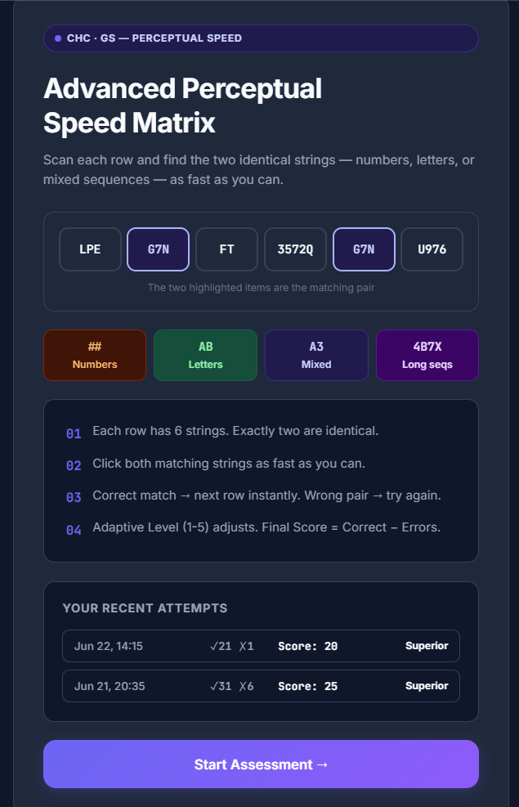
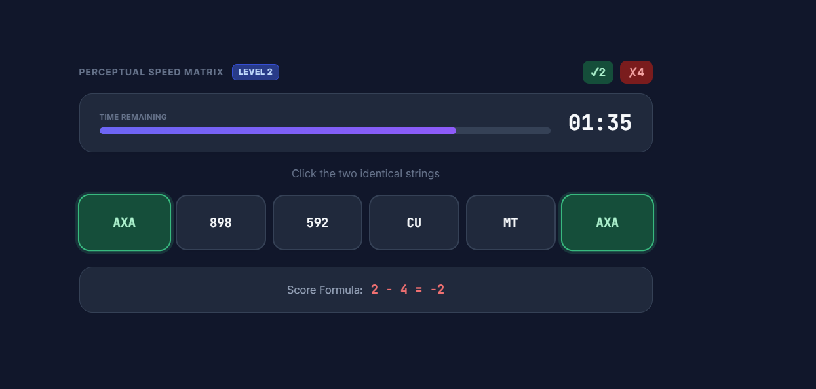
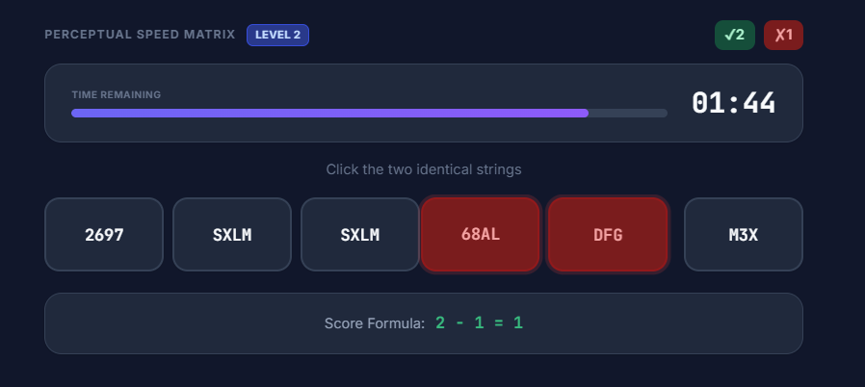
OLD MVP

Slide 7
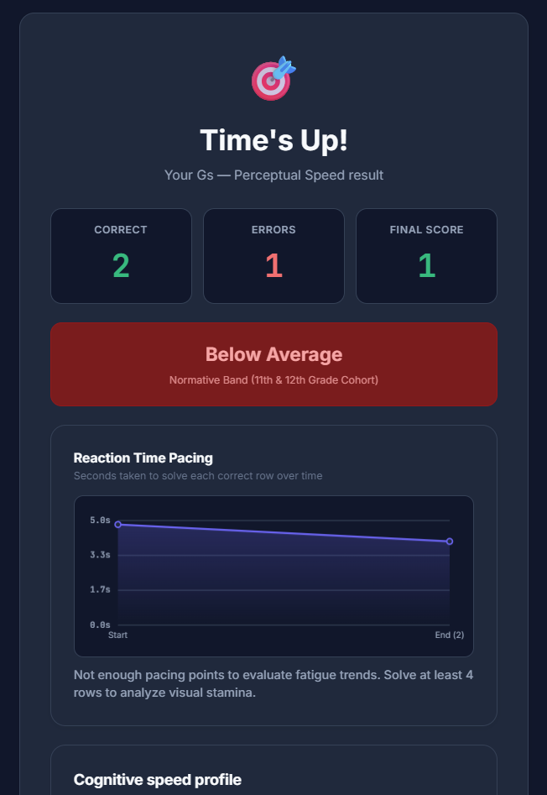
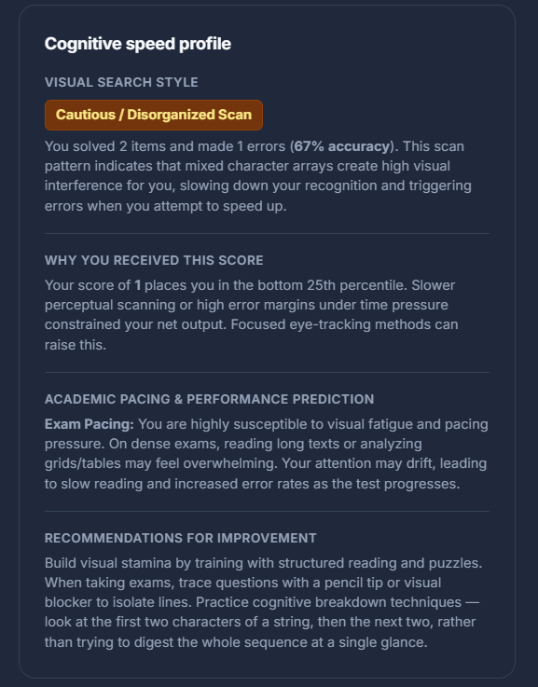
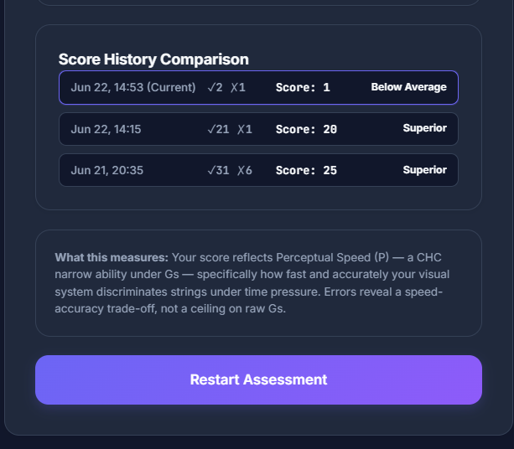
OLD MVP

Slide 8
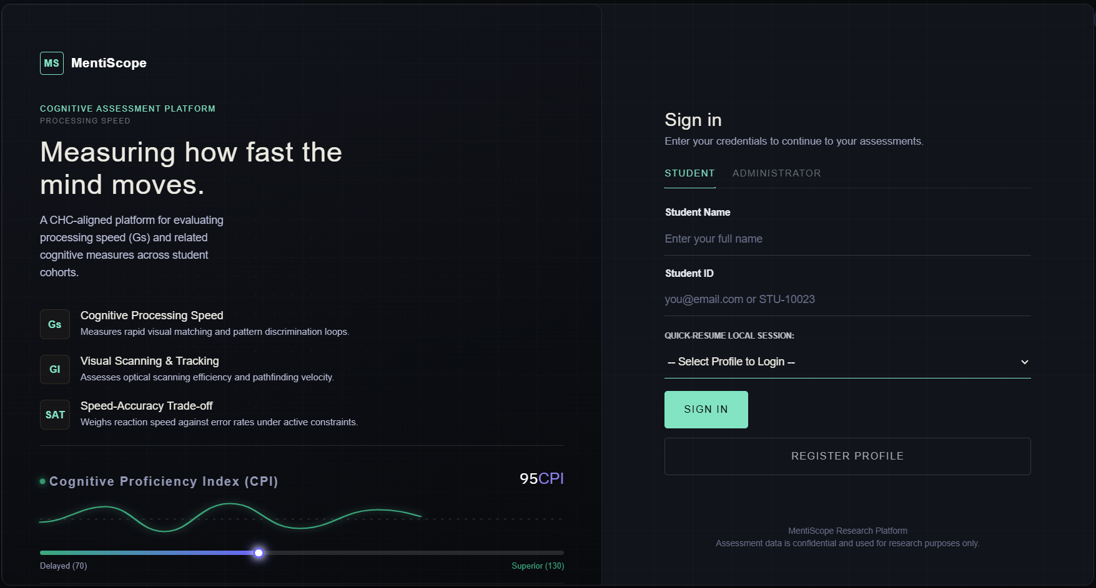
NEW MVP

Slide 9
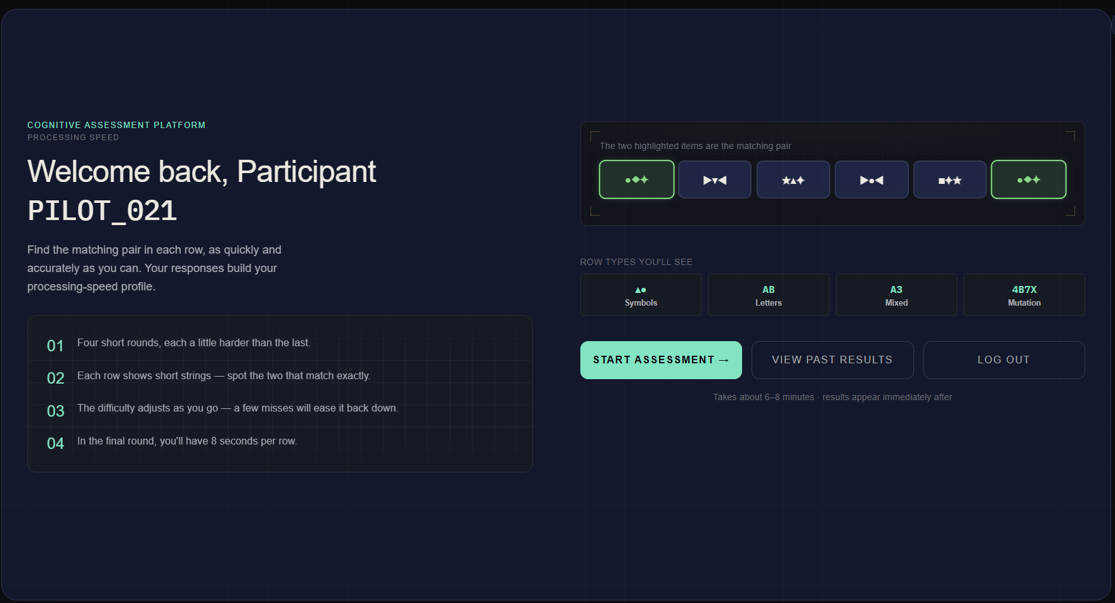

Slide 10
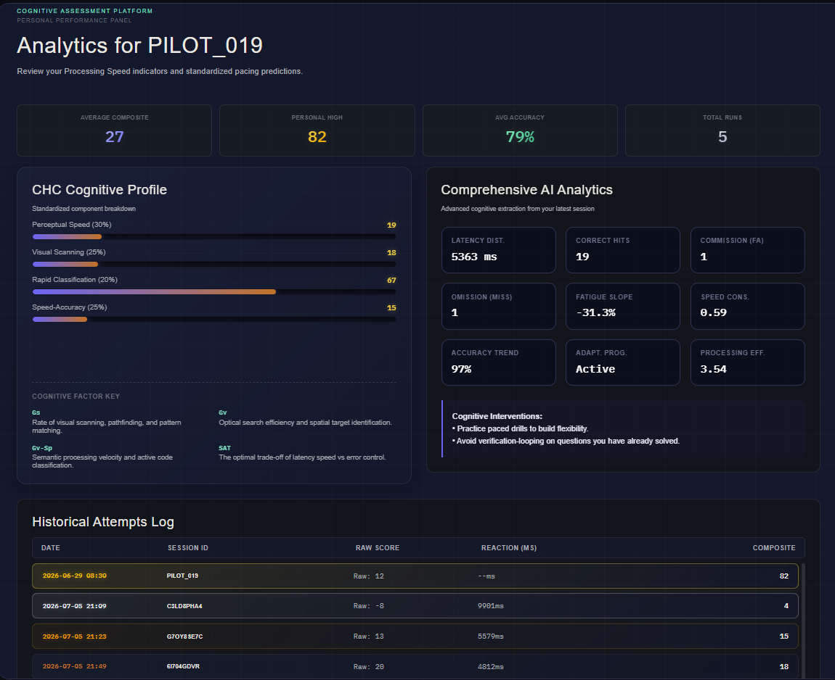

Slide 11
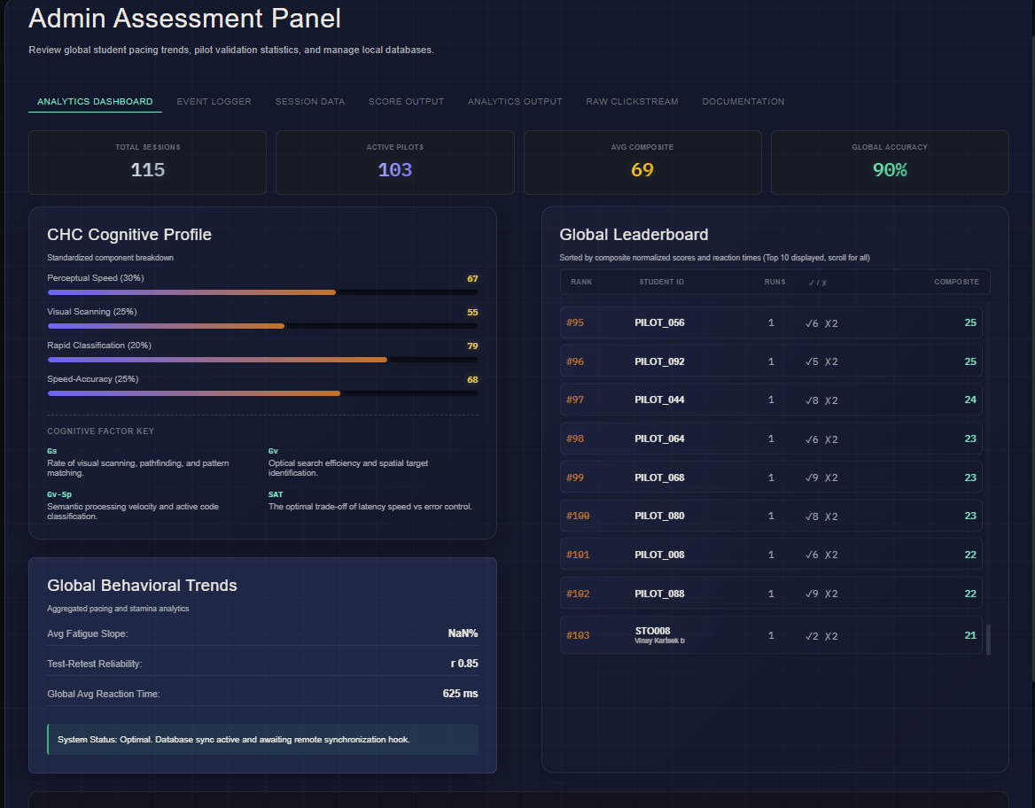

Slide 12
Thank You!

